Slide 1

FOUNDATIONS OF ARTIFICIAL INTELLIGENCE
Automated university examination and class time table scheduler
Team member 1: Santhosh G 240701473
Team member 2: Rohith D 240701435
Mentor: Mrs. Deepa

Slide 2

Abstract
Manual preparation of college class and examination timetables is time-consuming and often leads to student clashes, room double-booking, and uneven distribution of exams.
This project presents AeroChronos, an intelligent timetable scheduling system that uses Constraint Satisfaction Problem (CSP) techniques (Backtracking, MRV heuristic, and Forward Checking) to generate clash-free schedules, and Simulated Annealing to optimize soft constraints such as reducing back-to-back exams.
The system supports multi-stage exams (CT-1, CT-2, Practical, and End-Semester), provides personalized student timetables, real-time solver statistics, and a modern Angular-based graphical interface with optional Supabase cloud storage.
The result is a transparent, automated, and academically aligned solution that demonstrates practical application of AI search and optimization techniques.

Slide 3





Literature Survey
Traditional college ERP systems (e.g., VTOP and similar portals) mainly display pre-prepared timetables and offer limited automated conflict resolution.
Early scheduling systems relied on manual rules or simple heuristics, which struggle with large numbers of constraints.
Constraint Satisfaction Problem (CSP) has been widely applied in educational timetabling for handling hard constraints such as student and room conflicts.
Local search techniques, particularly Simulated Annealing, have shown good results in optimizing soft constraints like exam spreading and minimizing consecutive exams.
Most existing solutions are black-box systems with little transparency about how the final schedule was generated and limited support for multi-stage examinations.
Gap Identified: Need for a transparent AI-based system that combines CSP for hard constraints and Simulated Annealing for soft constraints, while providing clear solver statistics and multi-stage exam support.

Slide 4
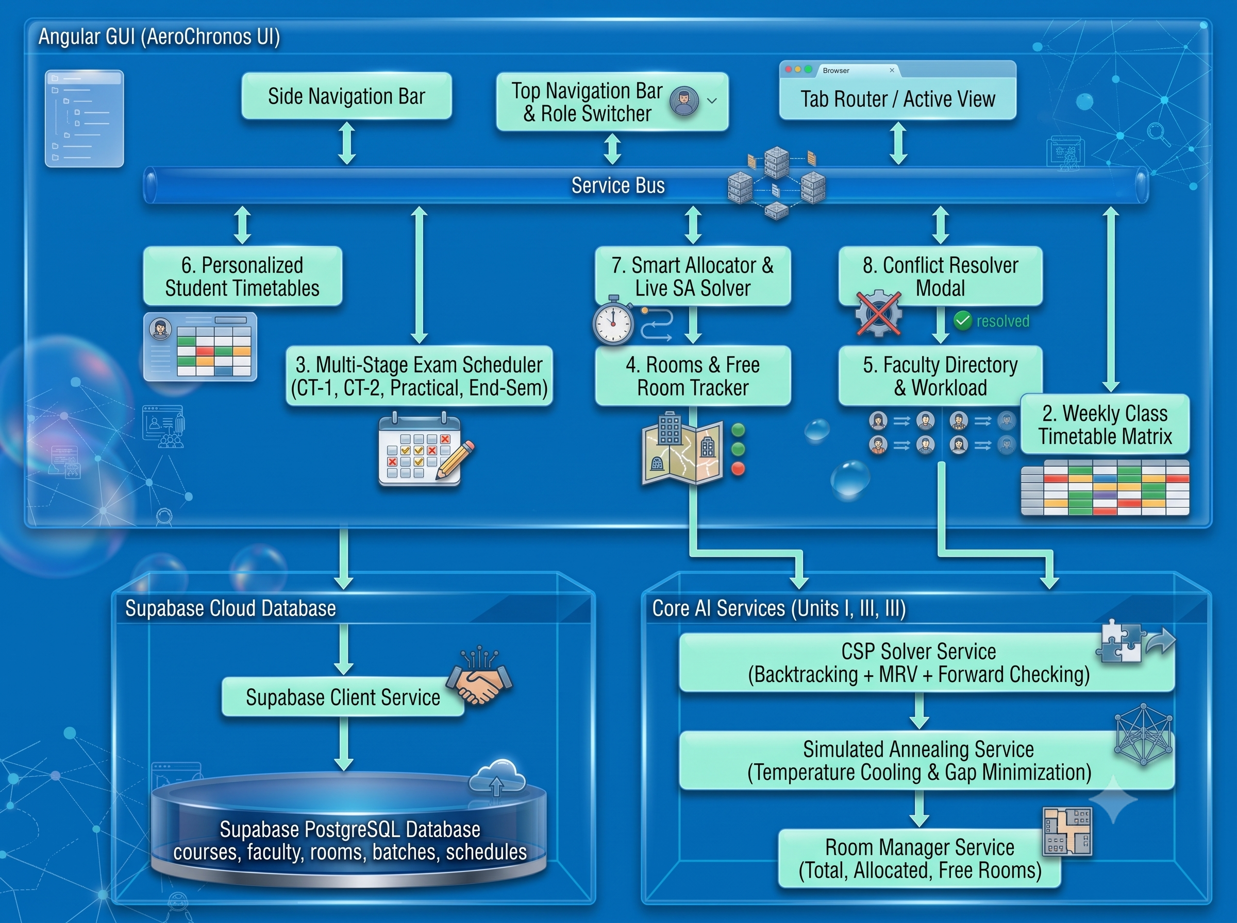




Architecture Diagram
Frontend
  Angular 21 (Standalone Components)
  TypeScript
  Tailwind CSS (for styling)
AI / Core Logic
  Constraint Satisfaction Problem (CSP)
  Backtracking Search
  Minimum Remaining Values (MRV) Heuristic
  Forward Checking
  Simulated Annealing (Local Search / Optimization)
Backend / Database
  Supabase (PostgreSQL database + authentication)
  Offline-first support (local data fallback when Supabase is not connected)
Tools & Others
  Node.js & npm (for Angular development)
  Visual Studio Code (recommended IDE)
  CSV export functionality (for student timetables & reports)
CSP generates valid schedule
User triggers “Smart Allocator”
Simulated Annealing optimizes soft constraints
Results displayed with live statistics and conflict check
Data Flow:

Slide 5
Modules
Dashboard Overview – Summary statistics and system status
Weekly Class Timetable – Interactive day-wise and period-wise grid
Multi-Stage Exam Scheduler – CT-1, CT-2, Practical, and End-Semester Theory
Rooms & Free Room Tracker – Room utilization and availability
Faculty Directory – Faculty profiles and teaching workload
Personalized Student Timetable – Individual student view with CSV export
Smart Allocator – Live CSP + Simulated Annealing solver
Conflict Resolver – Independent final conflict verification

Slide 6




Key Modules Explained
Smart Allocator
Runs the CSP engine followed by Simulated Annealing. Displays real-time metrics such as nodes expanded, backtracks, temperature, and objective cost.
Multi-Stage Exam Scheduler
Handles four distinct examination phases with appropriate room and batch constraints
Personalized Student Timetable
Merges class and exam schedules for any selected student and performs an additional conflict check.
Conflict Resolver
Acts as a safety layer to detect any residual clashes after the two separate solvers (class & exam) have run.

Slide 7
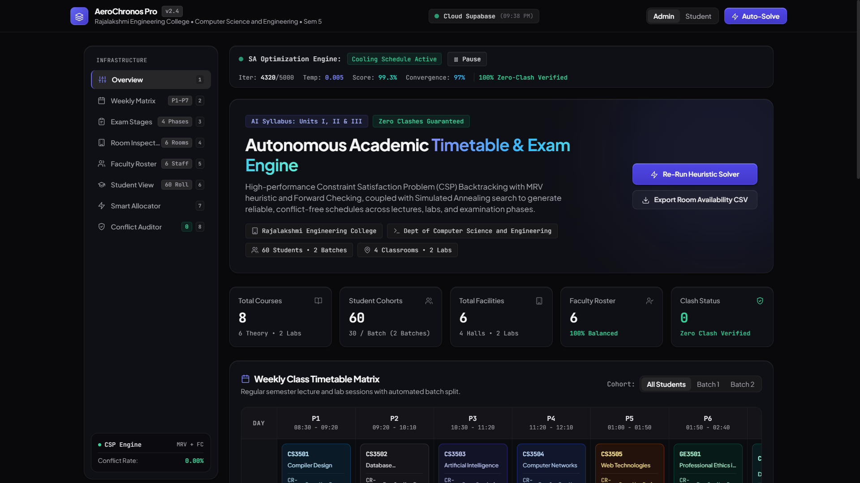
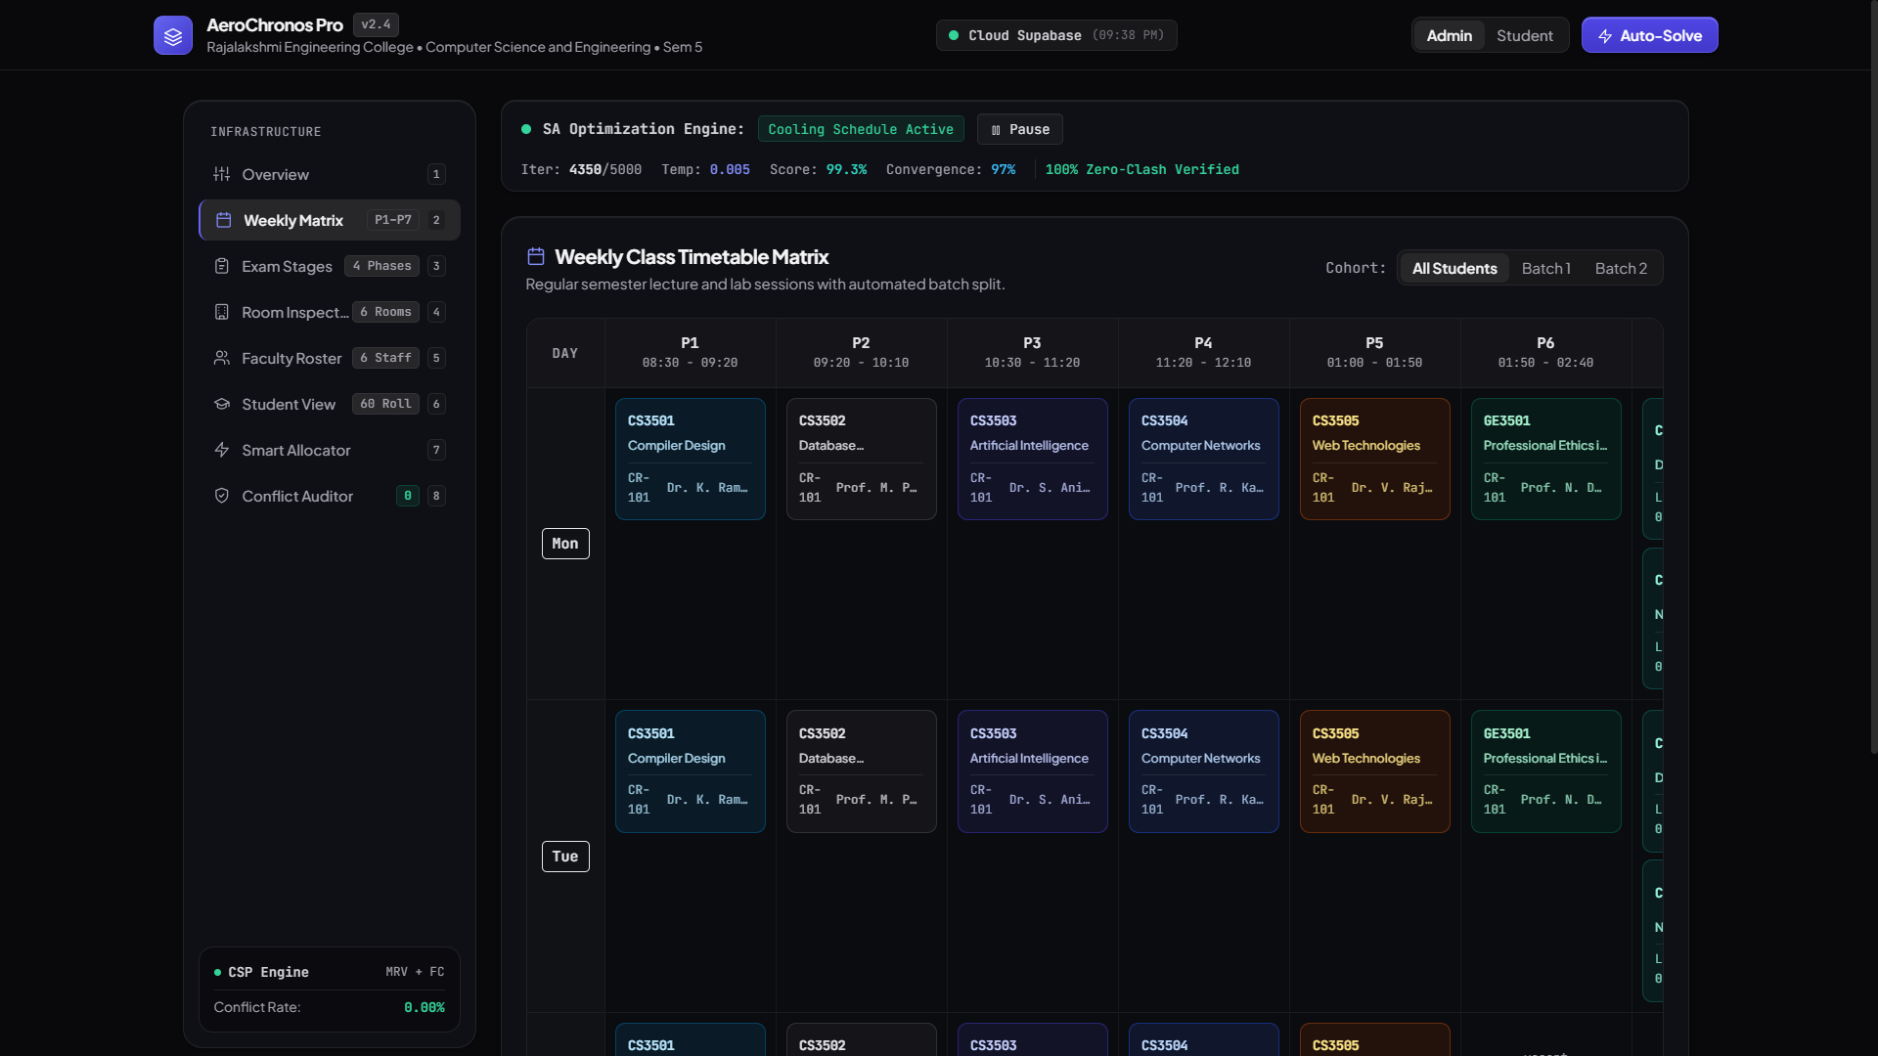
Output – Dashboard & Time Table
Dashboard Overview
Weekly Time Table

Slide 8
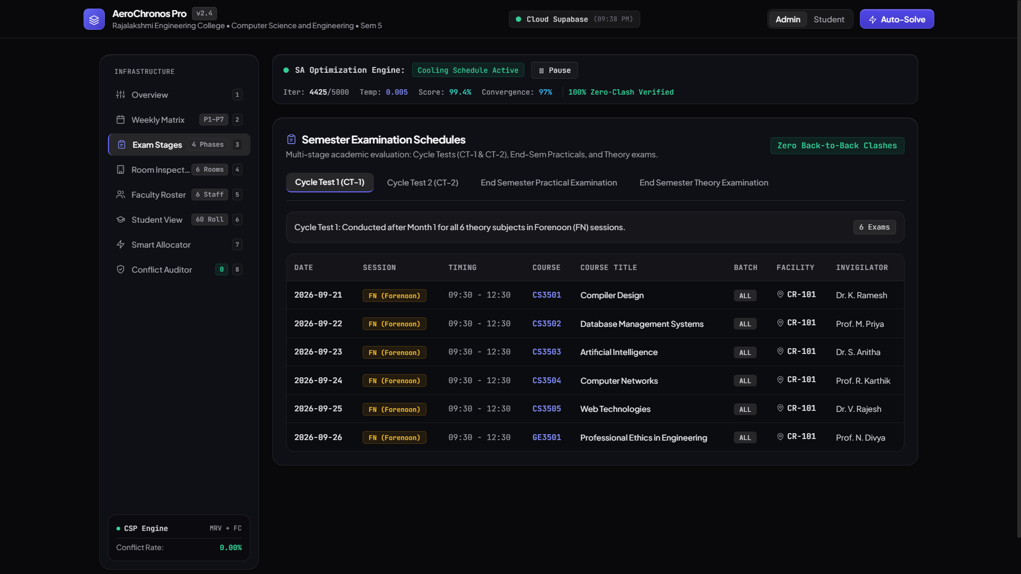
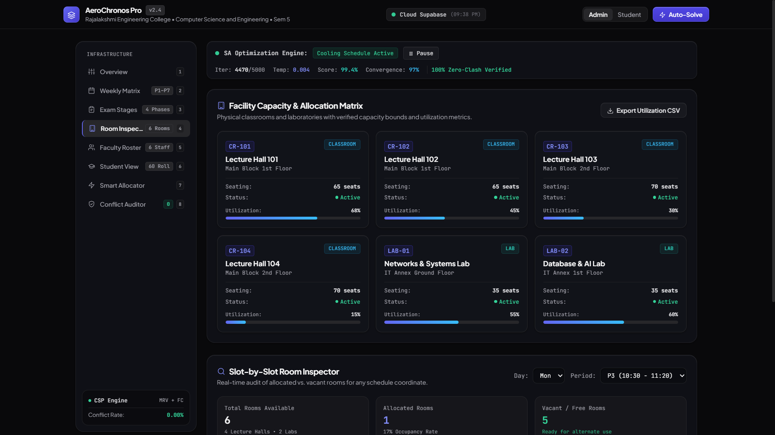
Output – Scheduler & Tracker
Exam Scheduler
Rooms Tracker

Slide 9
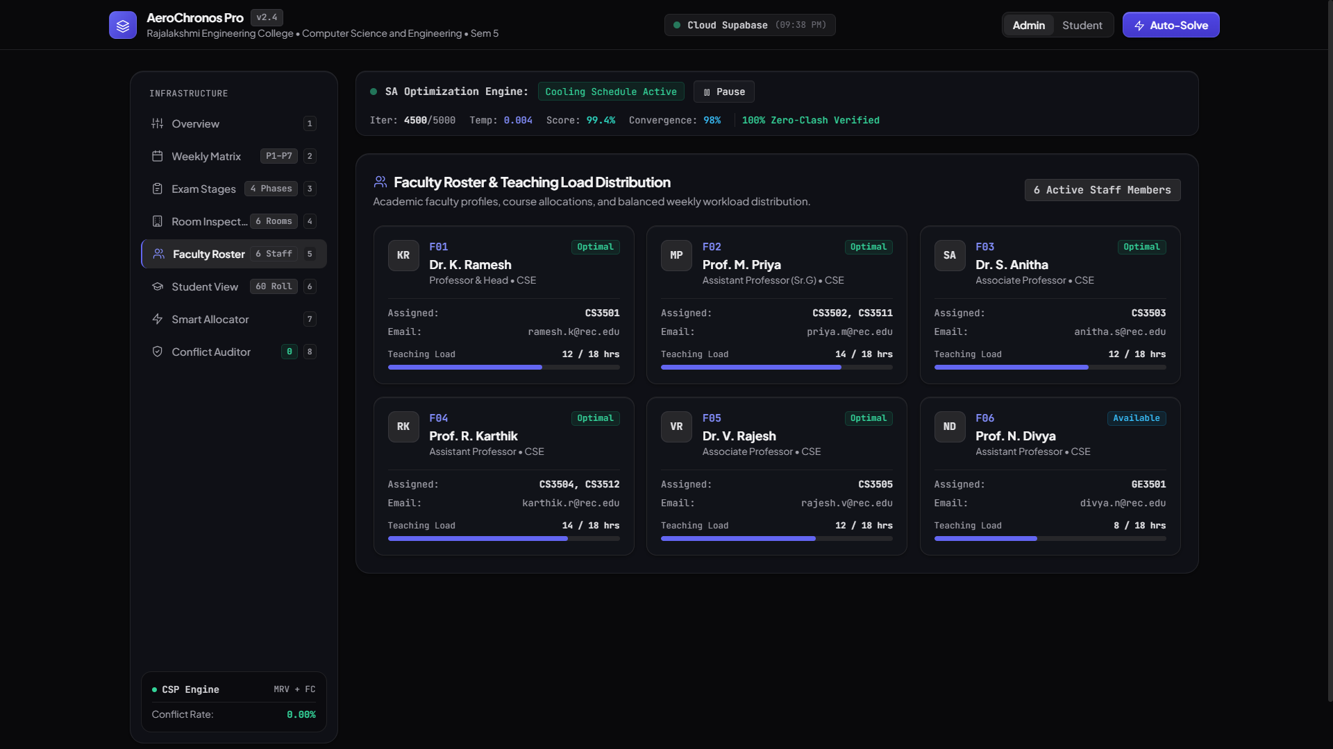
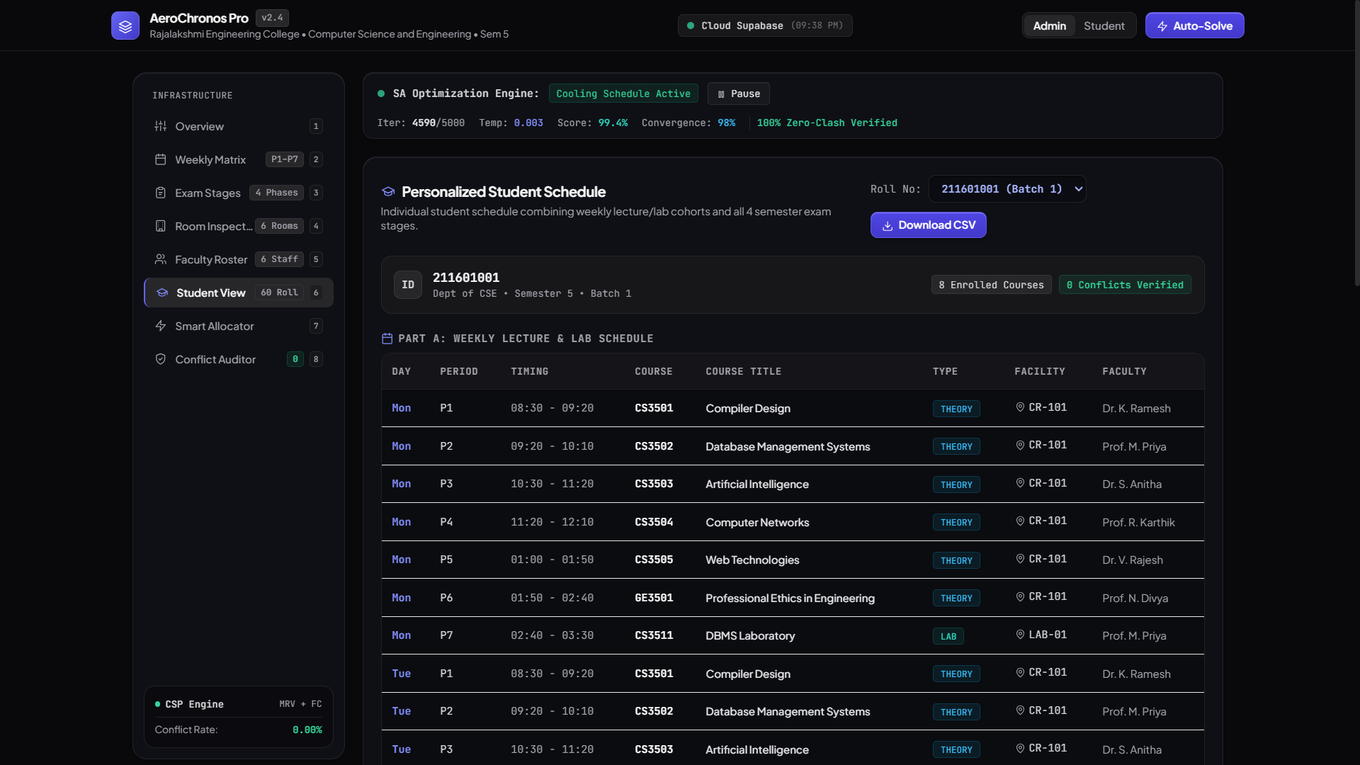
Output – Faculty & Personal Time Table
Faculty Directory
Personalized Student Time Table

Slide 10
Conclusion
AeroChronos successfully demonstrates the practical application of Constraint Satisfaction Problems and Simulated Annealing for real-world college timetable generation.
The system satisfies all hard constraints, optimizes soft constraints, provides algorithmic transparency, and offers a modern user-friendly interface.
It is well-aligned with FOAI course outcomes (Problem-Solving Agents, Local Search, and CSP) and can be extended for multi-department use and integration with existing college ERP systems.

Slide 11
Reference
[1] Minton, S., Johnston, M. D., Philips, A. B., & Laird, P. (1992). Minimizing conflicts: a heuristic repair method for constraint satisfaction and scheduling problems. Artificial Intelligence, 58(1-3), 161–205.
[2] Müller, T. (2001). Interactive Timetabling (Master's thesis). Charles University, Prague.
[3] Müller, T. (2002). Interactive Heuristic Search Algorithm. Proceedings of the CP'02 Conference - Doctoral Programme, LNCS 2470, 765.
[4] Rudová, H., & Murray, K. (2003). University course timetabling with soft constraints. Practice And Theory of Automated Timetabling, LNCS 2740, 310–328.
[5] Müller, T., & Rudová, H. (2004). Minimal Perturbation Problem in Course Timetabling. PATAT 2004 - Proceedings of the 5th International Conference on the Practice And Theory of Automated Timetabling, 283–303.
[6] Piechowiak, S., Ma, J., & Mandiau, R. (2004). EDT-2004: An open interactive timetabling tool. PATAT 2004 - Proceedings of the 5th International Conference on the Practice and Theory of Automated Timetabling, 305–321.
[7] Müller, T., Rudová, H., & Barták, R. (2005). Minimal Perturbation Problem in Course Timetabling. Practice And Theory of Automated Timetabling: Selected Revised Papers, 126–146.

